Slide 1



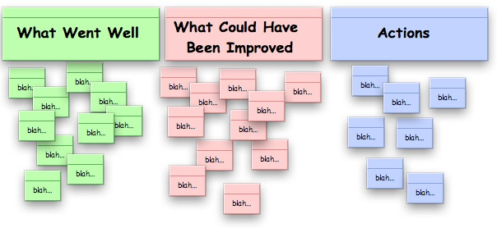
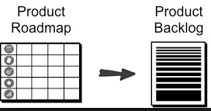

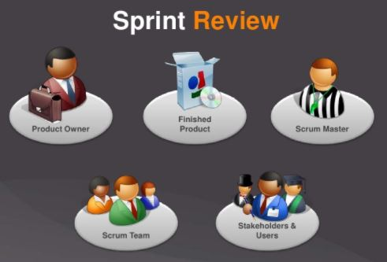





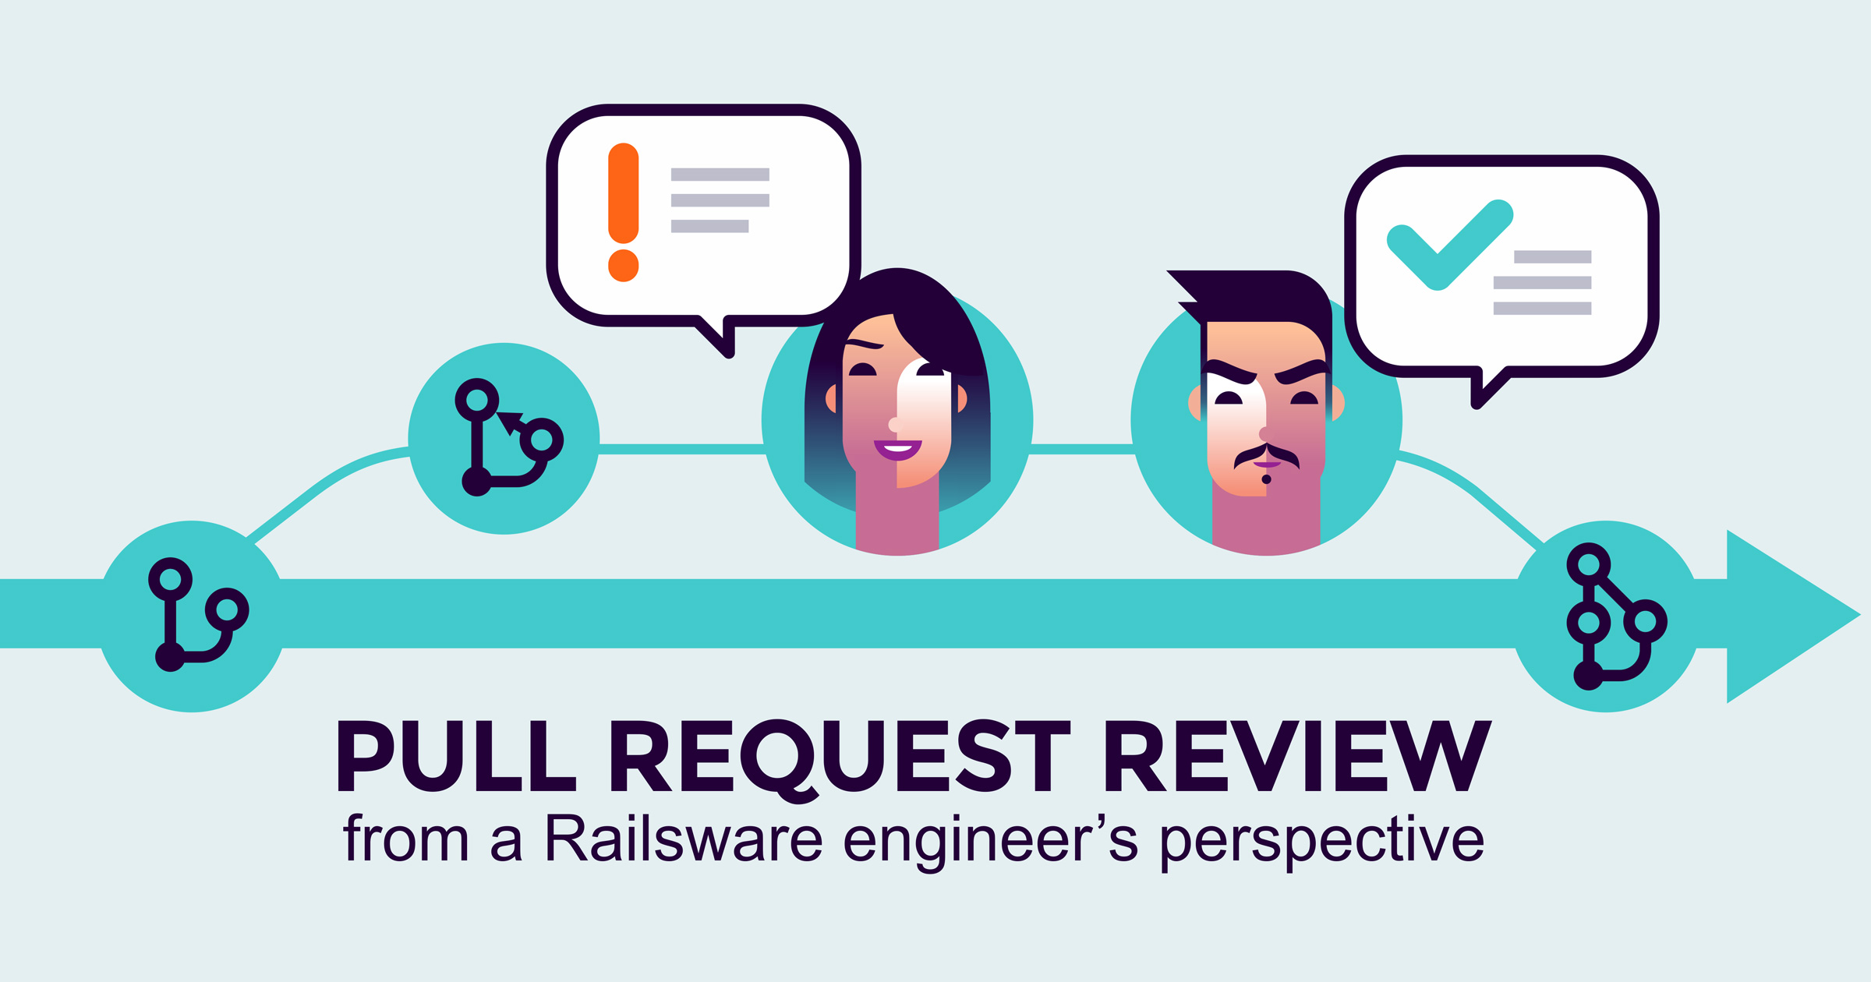












DEVOPS FOR JAVA
New Requirements
Ops Requirements
Major/Minor Enhancement
Bug Fixes
Content Collaboration
Sprint Retrospective
Retrospective template
Sprint Planning
Sprint/Release Metrics
Sprint Backlog
Daily standup meeting
Estimation Planning
Sprint Review/Demo
Create Done Criteria
Defect Tracking
Code Repo
Code Development
YES
Code Review
Regression Test
PASS
NO
NO
Rollback
Code Check-in
Build
Code Quality
Unit Testing
Integration
Binary Repo
Deployment
Monitoring
Notes:
Outcomes/Goals:
Increased Speed
Quality
Reliability
How:
Well defined processes
Culture
Automation – CI/CD

